Slide 1

Google Display Network
Building Successful Advertising Campaign

Slide 2
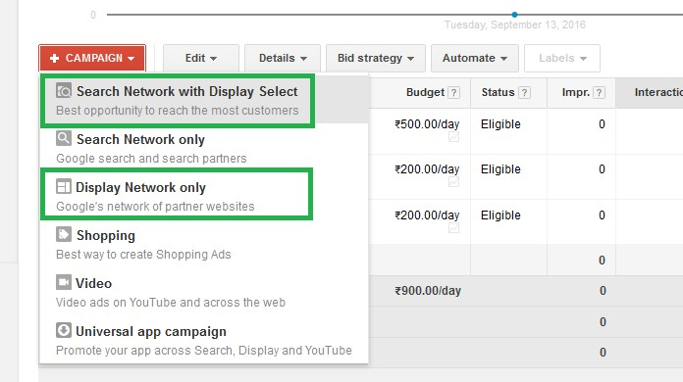
Campaign Setup
Choose “Search Network with Display or Display Network Only”

Slide 3
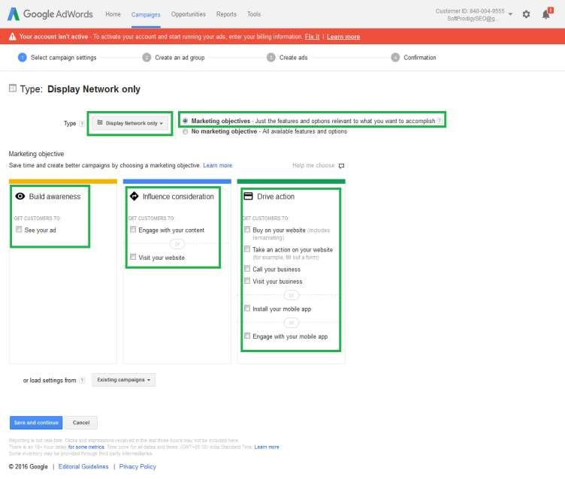
Campaign Setting
Display Network only
with: Marketing objectives

Slide 4
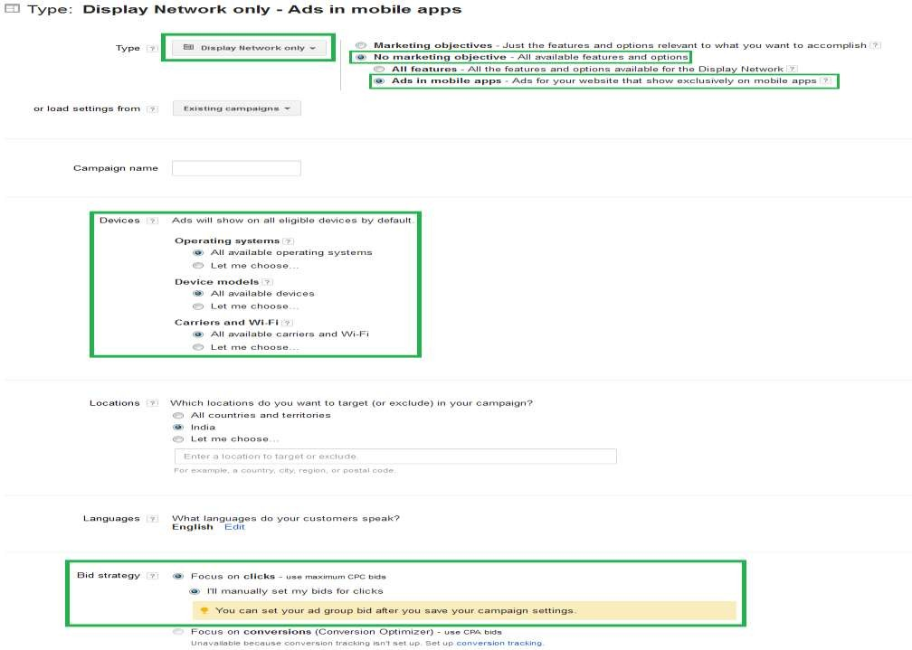
Campaign Setting
Display Network only
with: No Marketing objective

Slide 5
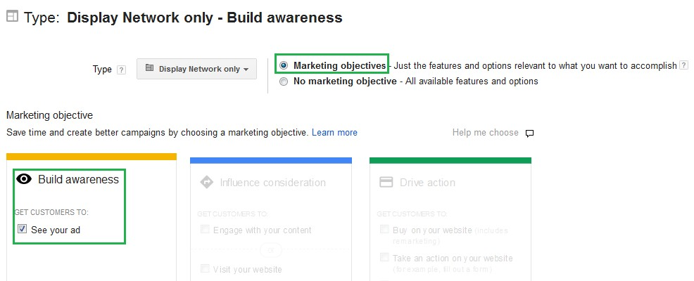
Display Network only
with: No Marketing objective

Slide 6
Display Network only
with: No Marketing objective (Built Awareness)
Increase brand awareness
The purpose of a brand-engagement campaign is to build awareness of and positive
associations with your company and its products and services. A customer can interact with your brand in a variety of ways, including watching videos, playing games, spending time on your website, or communicating with other customers.
If you're interested in increasing your brand awareness, the Google Display Network offers you the chance to connect with customers at the right time and place on thousands of websites worldwide. You can use placement targeting in AdWords to help reach a relevant audience for your brand, using rich-media ad formats and CPM bidding.
Brand-engagement campaigns can help you:
Increase interactions with your brand. Build more positive brand associations.
Increase brand loyalty by connecting with your target audience.
Motivate customers to engage with your brand and its associated products.

Slide 7
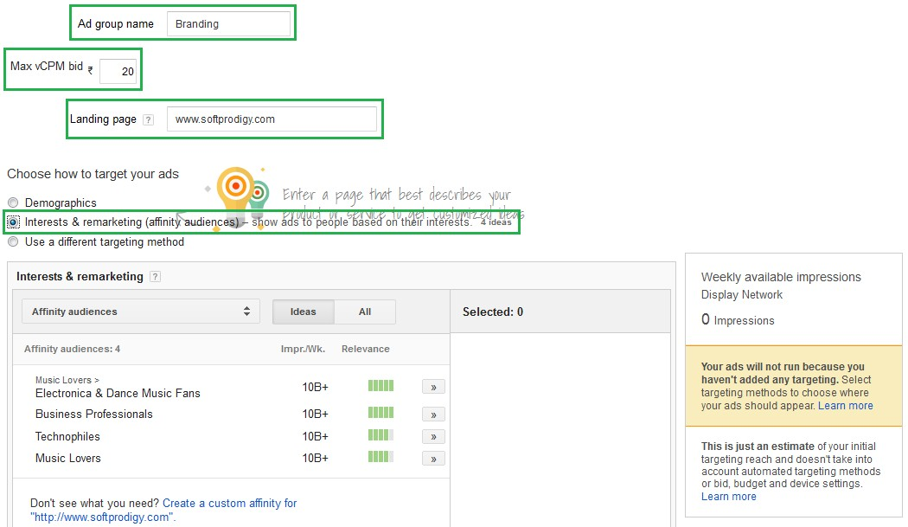
Ad Group
with: No Marketing
objective

Slide 8
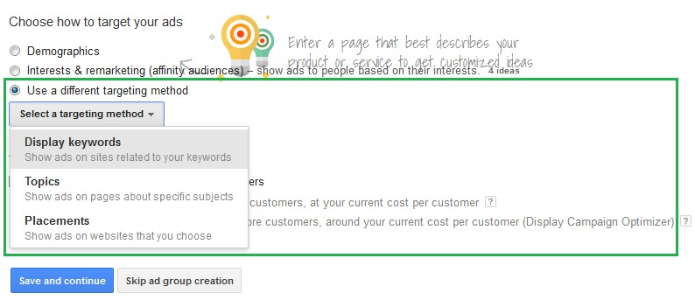
Ad Group
with: No Marketing
objective

Slide 9
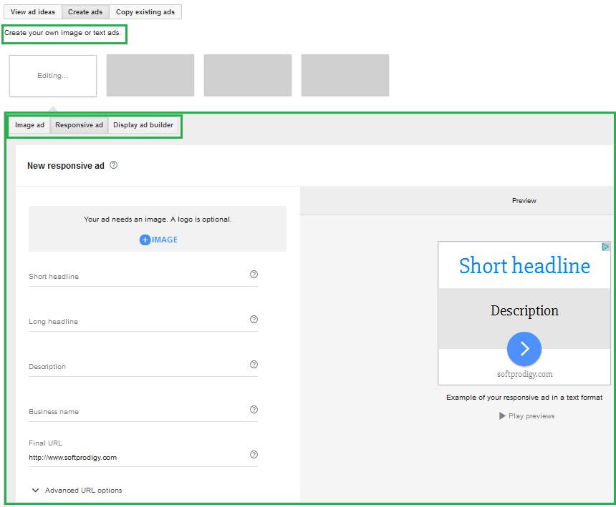
Ad Creation
with: No Marketing
objective

Slide 10
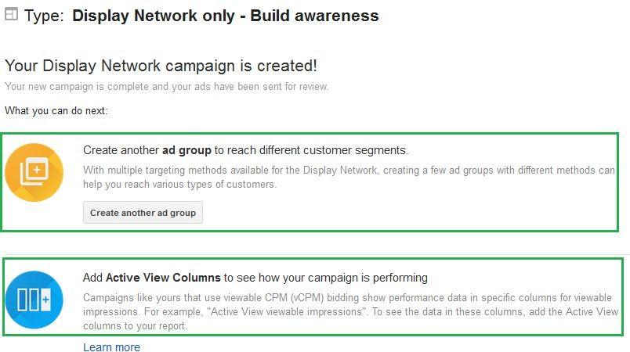
Ad Creation Done
with: No Marketing objective

Slide 11
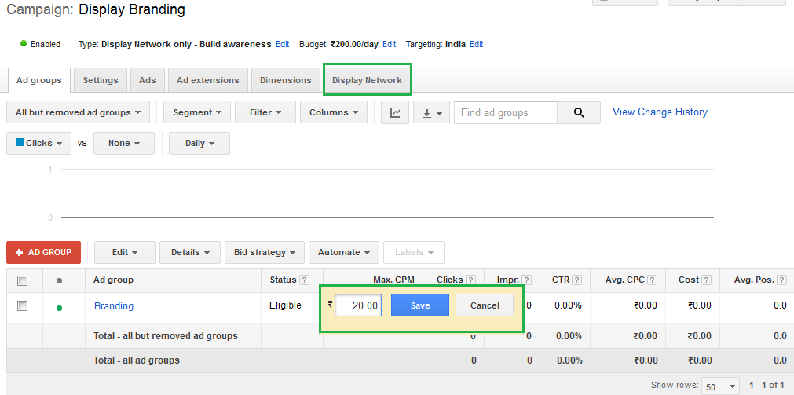
Ad Creation Done
with: No Marketing objective

Slide 12
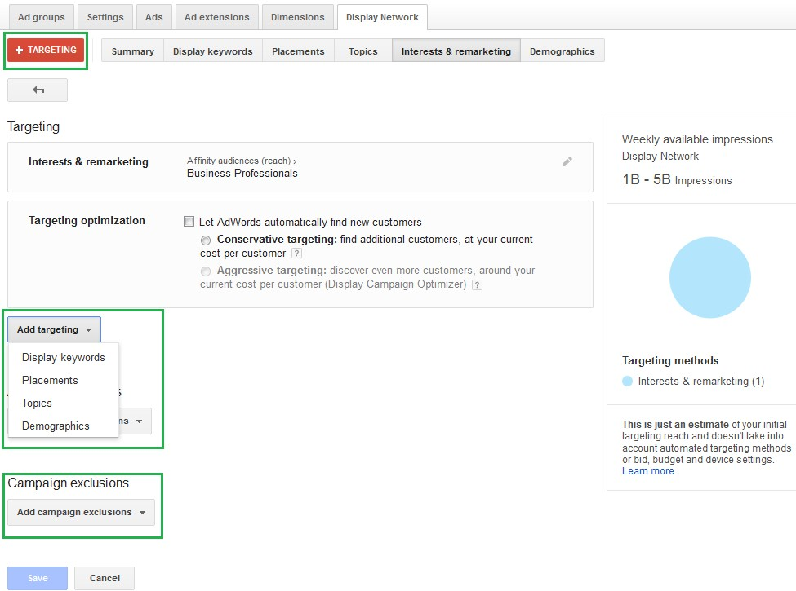
How to
change Target
with: No Marketing
objective

Slide 13
Display Planner
An AdWords tool that provides ideas and estimates to help you plan a Display Network campaign that you can add to your account or download.
Display Planner generates ideas for all the ways you can target the Display
Network. Targeting ideas are based on your customers’ interests or your landing page. They include keywords, placements (websites, videos, mobile apps, mobile app categories), topics, interests (affinities, in-market segments), demographics (age, gender), and remarketing.
Each idea comes with impression estimates and historical costs. Think of these estimates and statistics as a guide to help you plan your Display Network campaign, rather than to project future performance.
You can find Display Planner under the Tools tab in your account.

Slide 14
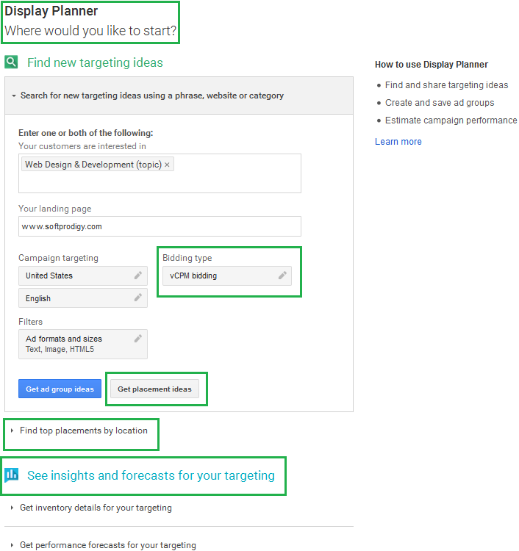
Display
Planner

Slide 15
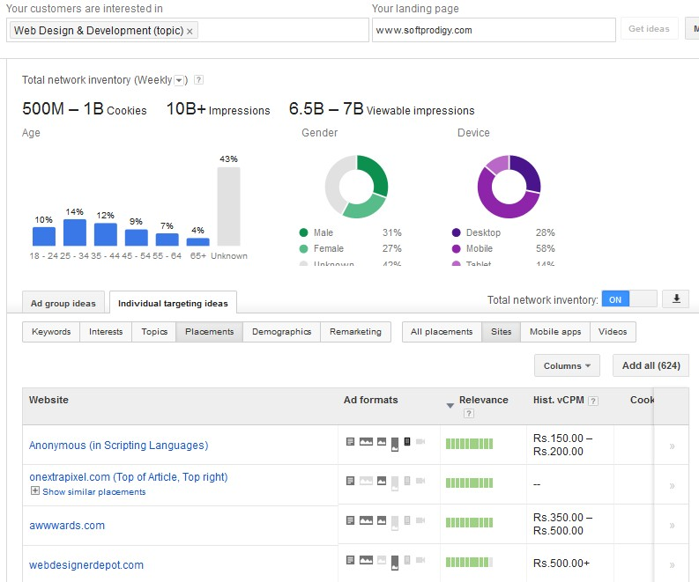
Display
Planner

